Slide 1
Easily Create Accessible Documents and Communications with Office 365 Peter Frem, Senior PM Anita Mortaloni , Principal PM

Slide 2
Microsoft Office Accessibility Mission
People with disabilities can create, consume, and communicate from any device
It’s easy for everyone to create and share accessible content

Slide 3
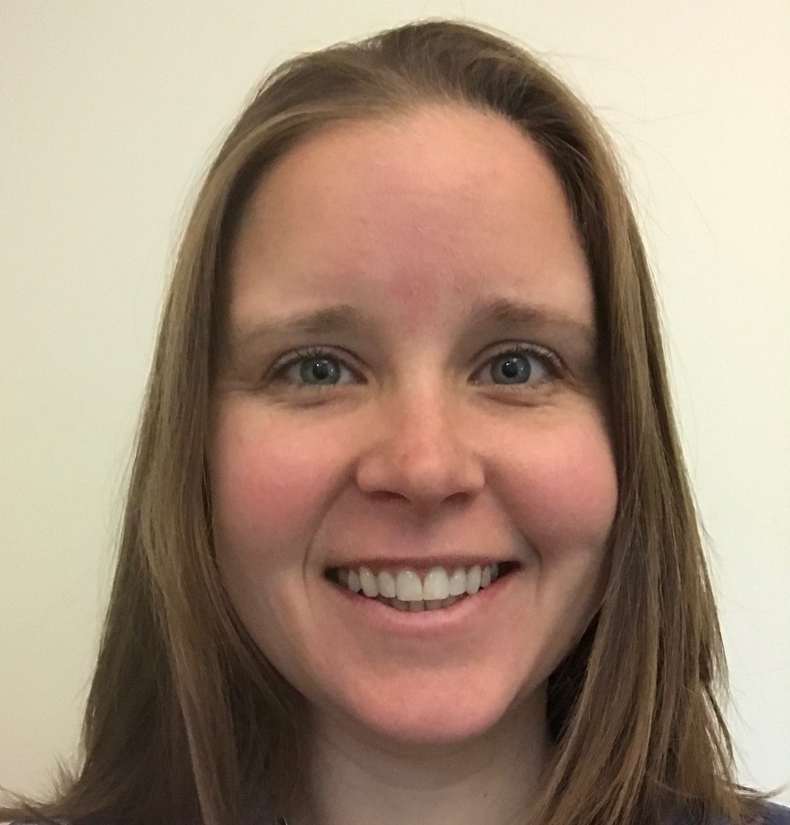

Meet the team
Anita Mortaloni
Principal Program Manager
CSUN 2018 Sessions
Wednesday 3/21 @ 11:00am
What’s New in Microsoft Office 365
Thursday 3/22 @ 8:00am
Strategies to Make your IT Applications More Accessible and Usable
Thursday 3/22 @ 4:20pm
Easily create accessible documents and communications with Office 365
Peter Frem
Senior Program Manager
CSUN 2018 Sessions
Thursday 3/22 @ 4:20pm
Easily create accessible documents and communications with Office 365
Friday 3/23 @ 4:20pm
Software architecture used in Microsoft Office for exposing accessible content

Slide 4
Accessible Authoring Journey in Microsoft Office Recap CSUN 2017
Timeline | Author | Review | Share
Office 2010 |  | New accessibility checker in Word, Excel, PowerPoint Desktop
Office 365 Released | New accessible templates, themes, styles Ubiquitous accessible authoring capabilities in any app on any device (e.g. alt text, headers) Artificial Intelligence faster creation of more accessible content (Alt Text, Editor, Hyperlinks) | Improved accessibility checker workflow, in-app guidance, and support Added accessibility checkers in Office Mac and Web | Improved tagged PDF generation New accessibility checker in Outlook PC and Mac New reminders when sending emails to users who prefer accessible content in Outlook Web

Slide 5
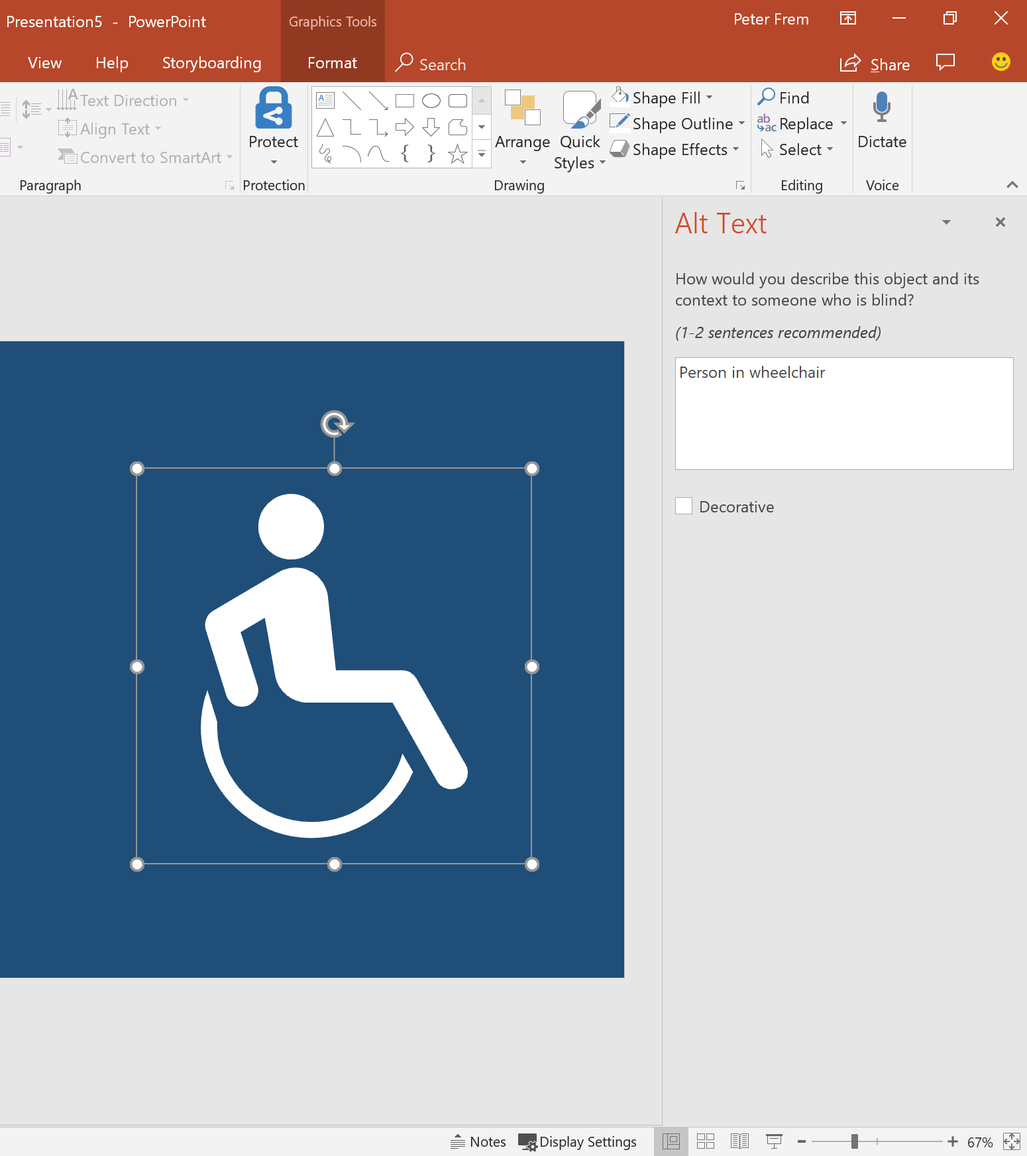
Create inclusively in PowerPoint Semantic slide layouts Reusable icons Simplified alt text workflow

Slide 6
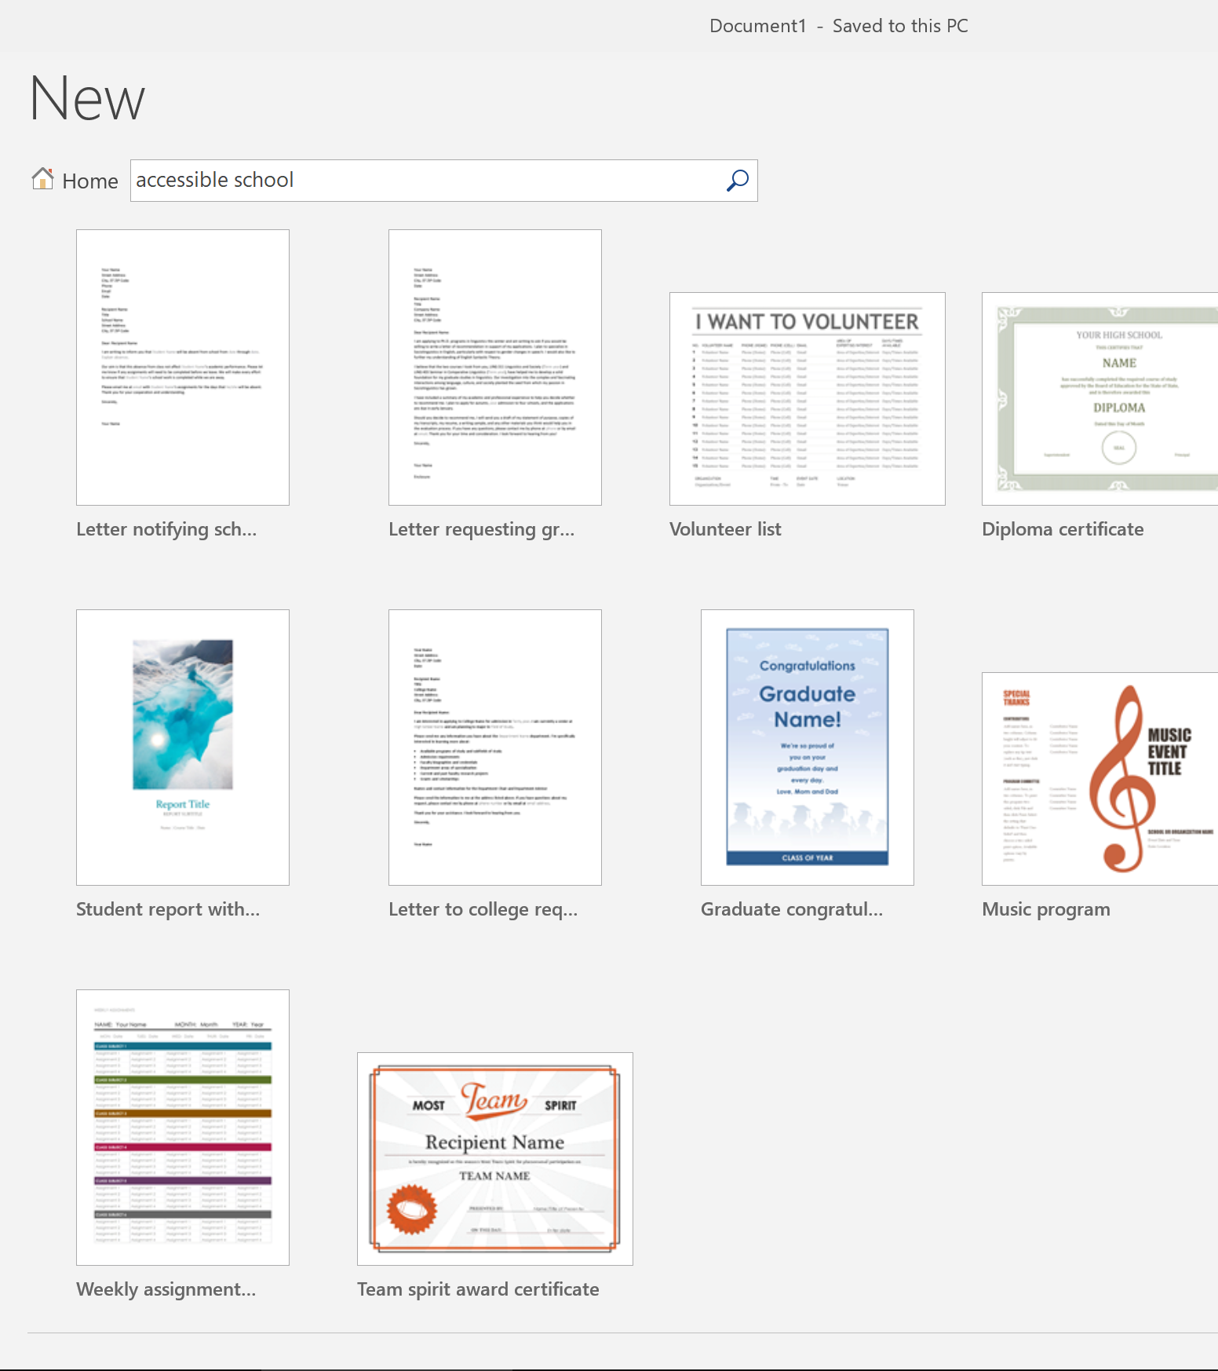
Create Confidently in Word Accessible Templates Editor Simplified accessibility checker

Slide 7
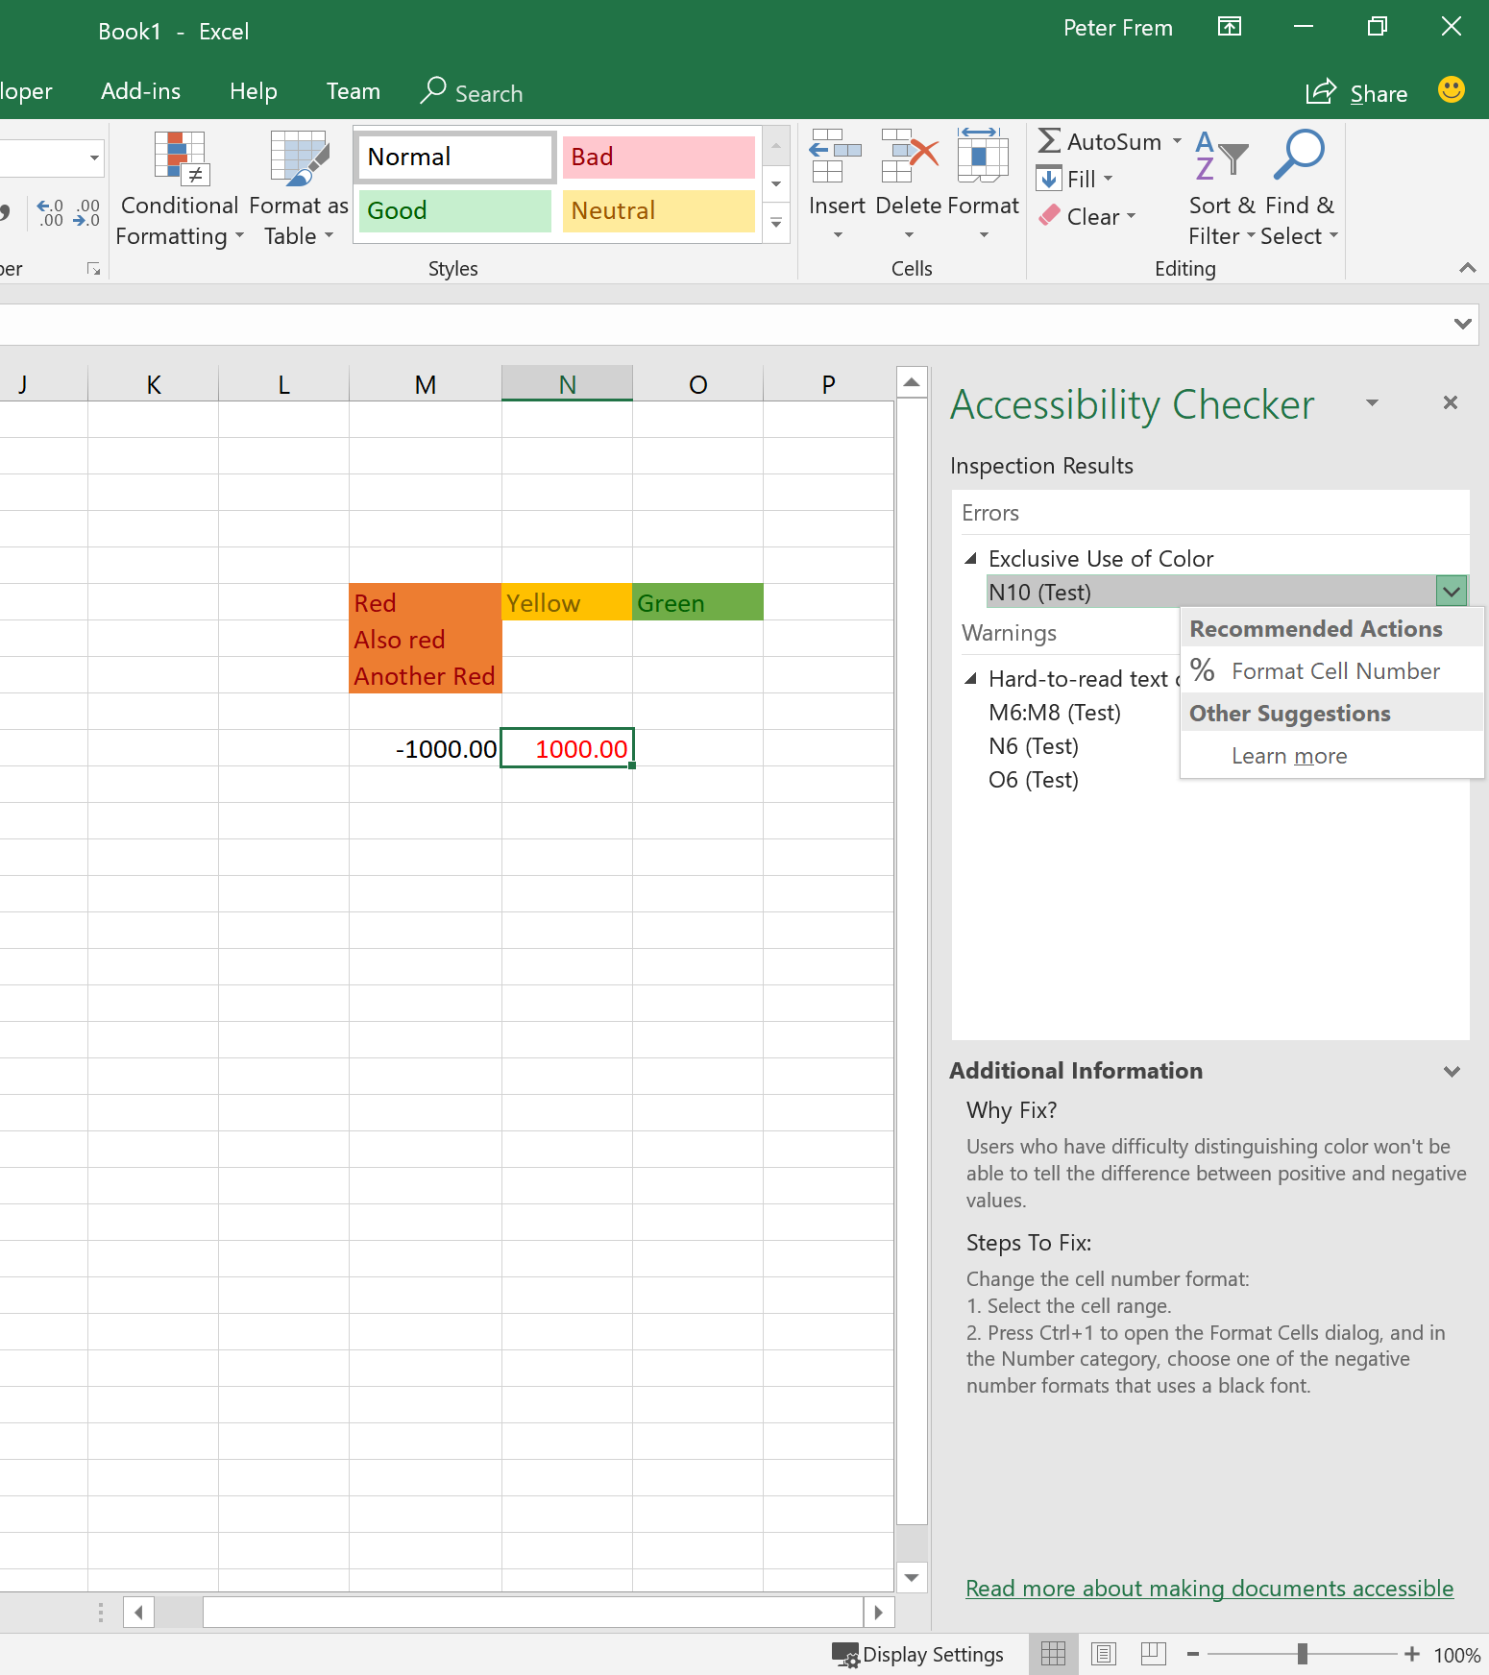
Create Confidently in Excel Ease of Access Settings Use of Color Alone Color Contrast Fix in Aggregate

Slide 8
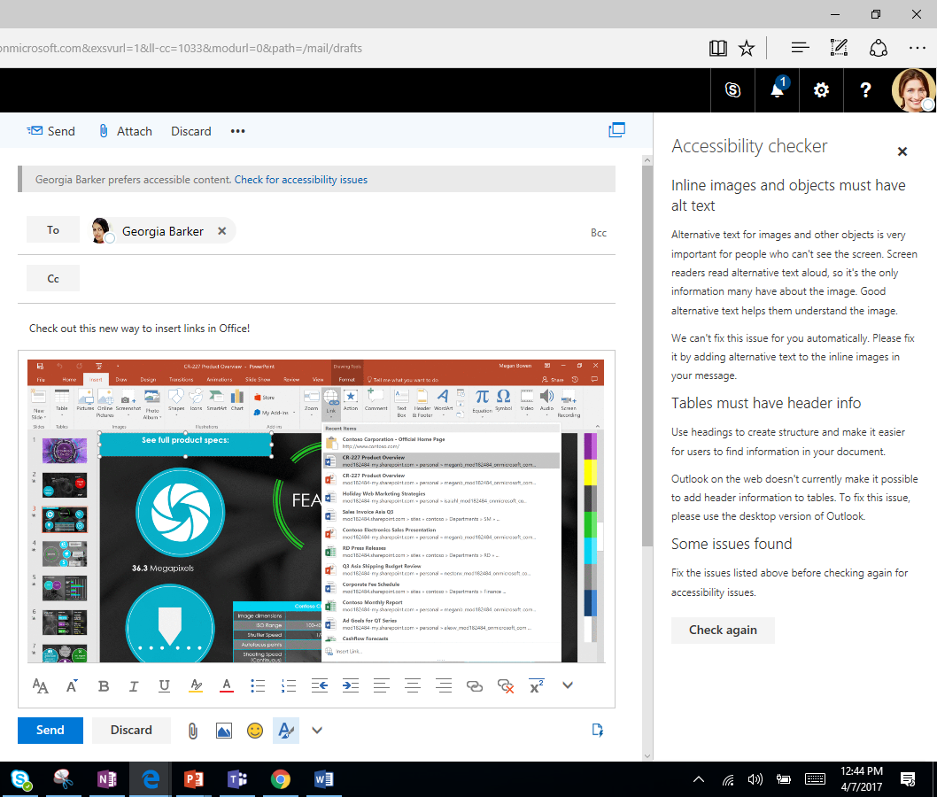
Communicate Inclusively in Outlook Mail Tips in Outlook Web Accessibility Checker

Slide 9
Accessible Authoring Journey in Microsoft Office Coming Soon to Office 365
Timeline | Author | Review | Share
Office 2010 |  | New accessibility checker in Word, Excel, PowerPoint Desktop
Office 365 Released | New accessible templates, themes, styles Ubiquitous accessible authoring capabilities in any app on any device (e.g. alt text, headers) Artificial Intelligence faster creation of more accessible content (Alt Text, Editor, Hyperlinks) Add captions to videos in PowerPoint | Improved accessibility checker workflow, in-app guidance, and support Added accessibility checkers in Office Mac and Web | Improved tagged PDF generation New accessibility checker in Outlook PC and Mac New reminders when sending emails to users who prefer accessible content in Outlook Web
Office 365 Coming Soon | Even more accessible templates Simplified alt text workflow | Updated accessibility checker rules New text contrast detection in Word, Excel, PowerPoint, Outlook, & OneNote Simplified accessibility checker experience with 1-click fix actions | New reminders when sending emails to users who prefer accessible content in Outlook PC

Slide 10
Tracking impact on accessible authoring metrics What are we seeing today?
4.7x
Increase in Users
4.6x
Increase in Usage

Slide 11
Tracking impact on accessible authoring metrics What can we learn next?
?
Most common accessibility issues created and shared
?
Issues least often fixed
?
Issues most often encountered by people using AT

Slide 12
Office 365 enables inclusive communication
AUDIO ACCESSIBILITY
VISUAL ACCESSIBILITY
TEXT ACCESSIBILITY
Ability to add closed captions for audio/video in PowerPoint and Sway
Automatic live captions for PowerPoint via Microsoft Garage Presentation Translator add-in
Automatic audio transcription for videos in Microsoft Stream.
Ability to add alternative text descriptions to visual objects in all apps
Automatic suggestions for alt-text for images in Word and PowerPoint
Ability to record narrations of PowerPoint slides and embed audio recordings in OneNote and Sway
Transform printed text into searchable Office files with OCR via Office Lens
Make content easy to navigate with built-in accessible Styles
Make hyperlinks more readable by adding display names, auto-generated for Recent Items in Link Gallery
ACCESSIBILITY CHECKERS
ACCESSIBLE TEMPLATES
EXPORT AND EMAIL ACCESSIBILITY SETTINGS
In Office PC, Mac and Online apps to easily find accessibility issues
With detailed guidance to fix issues
For Word, Excel and PowerPoint to get started on the right track
Searchable by keyword “accessible”
Export as tagged PDFs from Office
See MailTips prior to sending emails to those who prefer accessible content

Slide 13
Resources
Microsoft Accessibility
Microsoft Accessibility Site Microsoft.com/Accessibility
Twitter for news, insights, and updates @MSFTEnable
Accessibility support for organizations Aka.ms/Edad
Trainings and help articles
Office 365: Aka.ms/OfficeAccessibility
PowerPoint add-in for live subtitling: Aka.ms/PresentationTranslator
Tools to improve comprehension: OneNote.com/LearningTools
Dictate add-in for typing in Office with your voice: Dictate.ms
Office Lens app for scanning with OCR: Aka.ms/OfficeLens
Notes:
Holding slide during presentation Q&A

Slide 14
Office 365 Sessions at CSUN ATC
Aka.ms/CSUN2018
Wednesday 3/21
11am: What’s New in Microsoft Office 365
Thursday 3/22
8am: Strategies to Make your IT Applications More Accessible
11am: Create Inclusive Classrooms with Microsoft Education
1.20pm: Microsoft Reading, Writing and Learning Tools
3.20pm: Excel 101 Tips and Tricks
4.20pm: Easily create accessible content with Office 365
Friday 3/23
9am: Modernization of IT with SharePoint Accessibility
11am: Create Engaging and Accessible Presentations with PowerPoint and Sway
2.20pm: How I used Microsoft OneNote to Manage a Medical Crisis
4.20pm: Software Architecture in Office 365 for Exposing Accessible Content
Notes:
Holding slide during presentation Q&A

Slide 15
We want to hear from you.
Connect with us in person today or anytime through our support and feedback channels.
Disability Answer Desk for phone/chat/ASL Help: Aka.ms/AccessibilitySupport
User voice Forum for Accessibility Feedback: Aka.ms/AccessibilityFeedback

